Slide 1


BOOK THE DOCTOR
TEAM : KKMB
"Seamless Healthcare Access at Your Fingertips"
TEAM MEMBERS
Bigyan Shrestha
Dinesh Bajagain
Prajwal Bhattarai
Sandesh Khadka

Slide 2
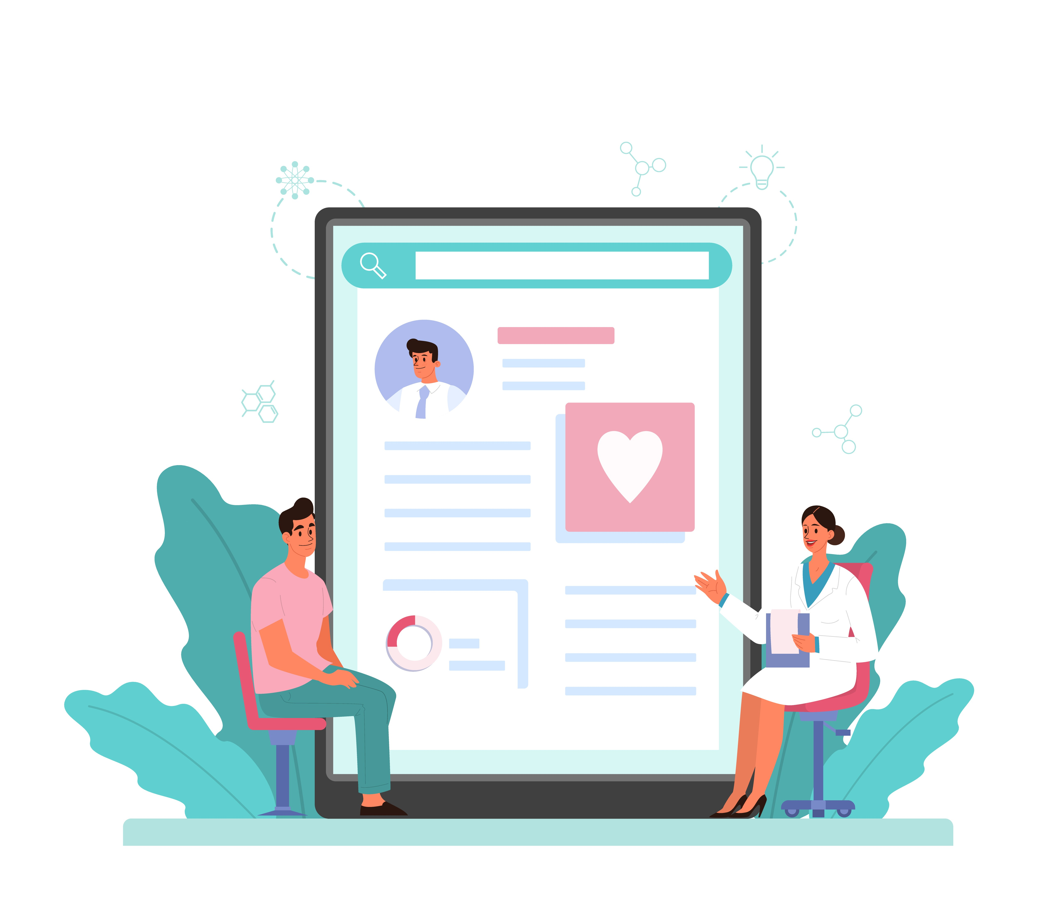
INTRODUCTION
Welcome to "BOOK THE DOCOTR", where healthcare meets convenience in the digital age. In today's fast-pace world, accessing quality health care should be as seamless as the click of a button. Our innovative project "BOOK THE DOCTOR", emerges as solution to bridge the gap between patients and healthcare providers by introducing a user-friendly, digital platform for scheduling medical appointments.

Slide 3





STATEMENT OF PROBLEM
High chance of data damage.
Time consuming while searching the data manually
Mistakes increase mess in record
Limited storage of record books

Slide 4
SOLUTION OVERVIEW
Our BOOK THE DOCTOR system is the answer to the growing need of the effective, efficient and reliable student data management.
User-Friendly Environment
Appointment History & Tracking
Secured
Saves Time
Reduce efforts
Improve Efficiency

Slide 5
FUNCTIONALITY
BOOK THE DOCTOR system offers a wide range of features that makes easy to manage doctor's and patient's data. The software shows a menu bar from where user can select the required services like:
Add Doctor Details
Search Specific Doctor Details
Display All Doctors Details
Edit Doctor Details
Delete Specific Doctor Details
Delete All Records

Slide 6

KEY FEATURES
The key features of the system include following things:
Login
Appointment Check
Appoint The Doctor
Doctor Information
Patient Information
Log Out

Slide 7
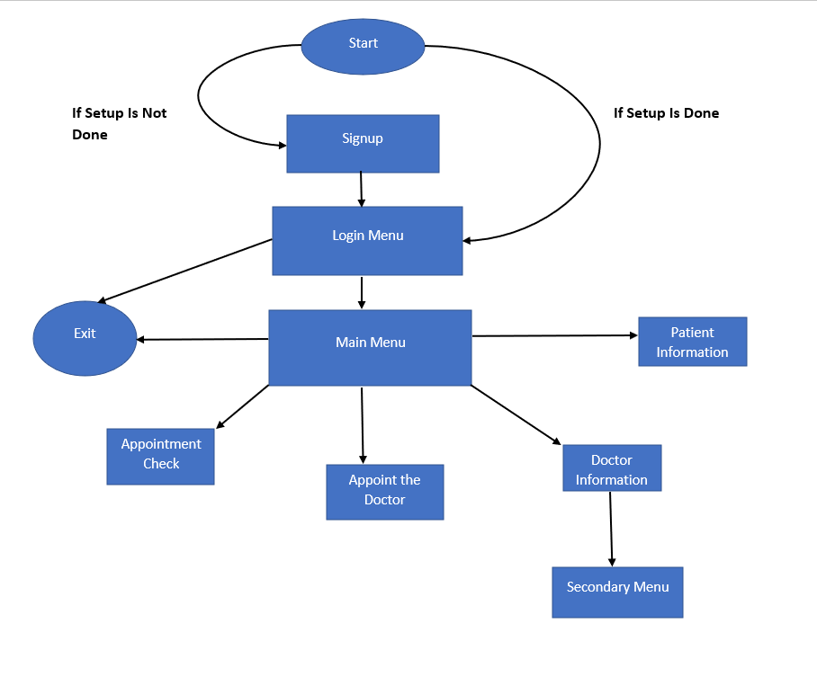
FLOWCHART

Slide 8
SYSTEM REQUIREMENTS
.Hardware:
PC with Pentium II Processor (260 MHz) or latest
32 MB of RAM or more
Hard disk with at least 50 MB of free space
Software:
OS Windows ( Windows XP, Windows 7, Windows 8, Windows 10)

Slide 9
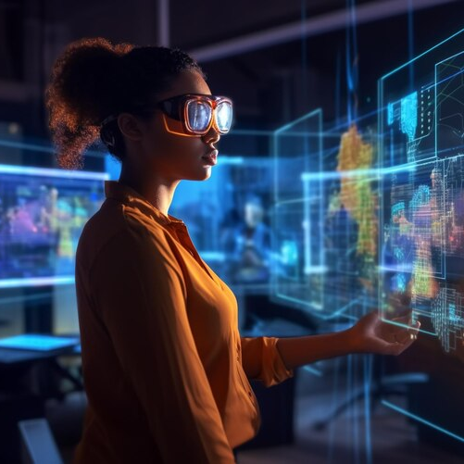
TECHNICAL DETAILS
BOOK THE DOCTOR is built using OOP in C++ that uses concept of Inheritance and file handling to ensure security and reliability. The system is designed to handle large volume of data with ease, while ensuring that the data can be accessed easily at the time of need.

Slide 10
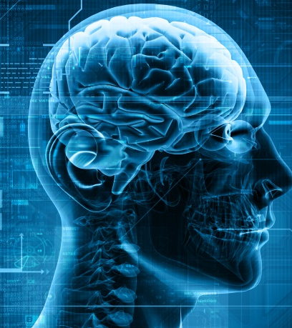
FUTURE ENHANCEMENTS
We are looking further on improving the following aspects and features of the software in the future :
Web-Based
Graphics & Attractive Interface
Cloud Storage
Automatic Refreshment

Slide 11

CONCLUSION
In summary, BOOK THE DOCTOR revolutionizes healthcare administration by digitizing and simplifying the appointment process. With its user-friendly interface, and secure data handling, the system not only enhances efficiency but also improves patient experience. This project sets the stage for a more streamlined and accessible healthcare future.

Slide 12
REFERENCES
Open AI. “ChatGPT.” Chat.openai.com, Open AI, 30 Nov. 2022, chat.openai.com/. Accessed 6 Dec 2023.
Open AI. “ChatGPT.” Chat.openai.com, Open AI, 30 Nov. 2022, chat.openai.com/. Accessed 7 Dec 2023.
Jain, Sandeep. “GeeksforGeeks | a Computer Science Portal for Geeks.” GeeksforGeeks, Sandeep Jain, 27 Mar. 2023, geeksforgeeks.org. Accessed 7 Dec. 2023

